Slide 1
COMISIÓN FAMILIAS
FAMILY INVOLVEMENT
Mª Dolores (CEIP 6 de Diciembre)
Mª Dolores (EEI Zaleo) Mª Rosa (Parma)
Guadalupe (CEIP 6 de Diciembre)
Mónica (AMPA) Familias de Parma
Pilar (IES Pérez Galdós)

Slide 2
Introduction
No students education without families
The idea is to address the family at different times of the evolutionary process of the students
What is the internal "occupation" in the family environment? .

Slide 3
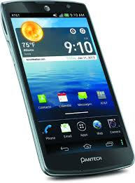
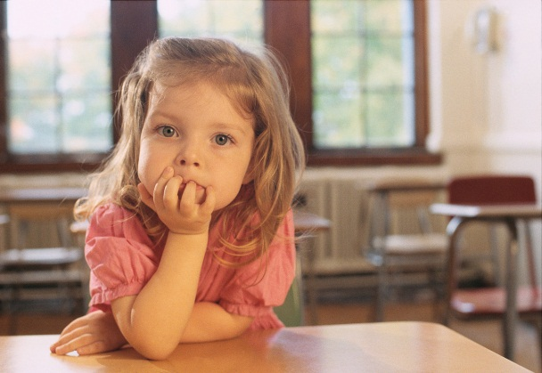
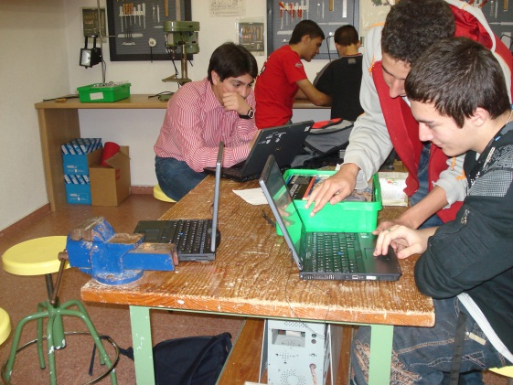

Slide 4
Topics
Family-School Relationship
Family-child relationship
Participation
Collaboratión E/A
Training
What has changed?
Are we feeling safe?
Do we know teaching to use ICT?
Communication

Slide 5
Topics
Family-School Relationship
Communication
Participation
Collaboratión E/A
Training
Family-child relationship
What has changed?
Are we feeling safe?
Do we know teaching to use ICT?

Slide 6
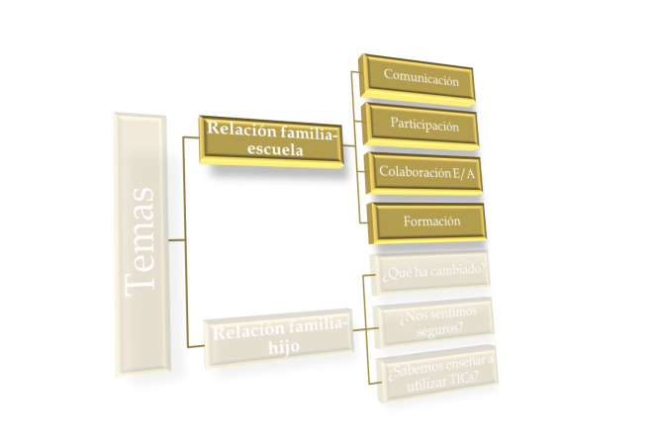
Family-School Relationship
  Comunication:
  Advantages and disadvantages of using de ICT
  Participation:
    How, to what extent, we do well?
  E/A Colaboration:
  Does it make it easier?
  Formation
  Is it collaborative?

Slide 7
Families in the EEI Zaleo

Slide 8
Topics
Family-School Relationship
Communication
Participation
Collaboratión E/A
Training
Family-child relationship
What has changed?
Are we feeling safe?
Do we know teaching to use ICT?

Slide 9
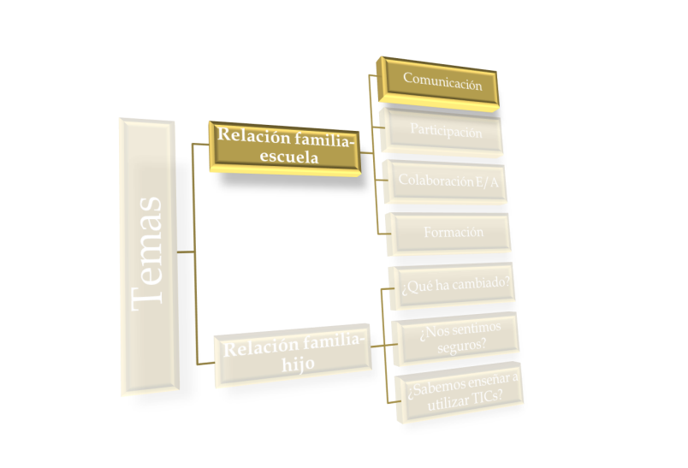
Comunication
CEIP 6 of December
Comunication
Advantages:
Faster access in the comunication and information with the school
Immediacy to solve specific problems with the families
Educative Process Monitoring (Platform EDMODO)
Direct comunication via mobile (calling or using wassapp) between some members of the AMPA and the Director to solve urgent problems
inconvenientes:
Mails from parents with false identities to critize the work of a teacher (anonymous)

Slide 10
Comunication
IES Pérez Galdós
No need for the parents to stay there.
Platform Edmodo
Afdi
Institutional Mail
Center webpage

Slide 11
Our experience tell us:
Advantages:
The posibility to contact without the student as an intermediary.
Faster comunication
Knowledge about the educative process (scholar trips, homeworks, absence of their children, evaluation criteria)
Disadvantages:
Not all the families have access to this.
Not all the teachers agree: Can they do this? Do they want this?
To what extent do we expect the immediacy?

Slide 12
Topics
Family-School Relationship
Communication
Participation
Collaboratión E/A
Training
Family-child relationship
What has changed?
Are we feeling safe?
Do we know teaching to use ICT?

Slide 13
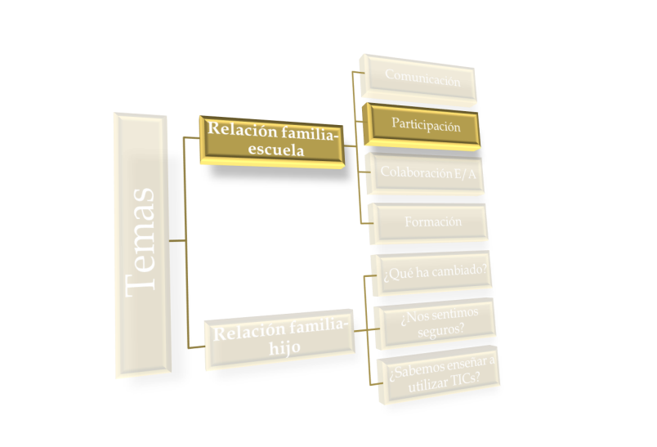
Participation
CEIP 6 de diciembre
With the New Technologies: The parents can participate
in the AMPA blog (comments, sugerences, ideas, etc.-)
institutional mail of the center (interesting files)
With the MCS project Debate with the families
Video ((http://www.youtube.com/watch?v=Kj3Qryc0FwM))
Lecture given by an expert about the safe use of the internet
Collaborative activity of the AMPA at the school for students using the ICT (Gacetilla)

Slide 14
Participation
IES Pérez Galdós
Debate with a small group of parents

Slide 15
Topics
Family-School Relationship
Communication
Participation
Collaboratión E/A
Training
Family-child relationship
What has changed?
Are we feeling safe?
Do we know teaching to use ICT?

Slide 16
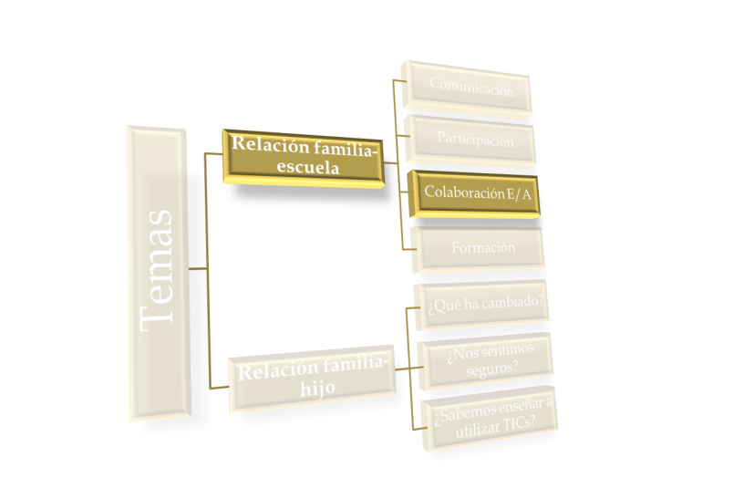
COLABORATION E/A
CEIP 6 of December
Is it possible the direct comunication with the students via ICT? (they don’t have email, they have no mobile)
Platform EDMODO with the students of 6th to see if it can be extended to other levels of Primaria

Slide 17


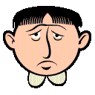
Colaboration
IES Pérez Galdós

Slide 18
Topics
Family-School Relationship
Communication
Participation
Collaboratión E/A
Training
Family-child relationship
What has changed?
Are we feeling safe?
Do we know teaching to use ICT?

Slide 19
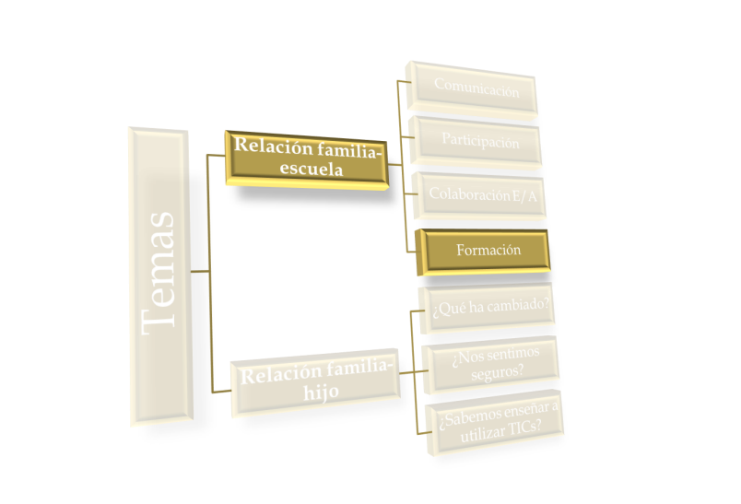
Training
CEIP 6 of December
From the project MCS the students know the permissions and licenses of internet (CreativeCommons) and at the same time they give their parents new knowledges.
Lecture with a monitor of C.Cultural Pablo Iglesias at the school for teachers and parents, where it was shown a great variety of creative activities with the ICT and the Internet.
The link to the lecture is at the MCS webpage

Slide 20
Training
IES PÉREZ GALDÓS
Group meetings at the sunset of the curse.
Using the webpages for Educational Guidance.
Participation at the Proyecto Orión
(webpage)
Lecture given by an expert about the safety at the social networks.

Slide 21
Topics
Family-School Relationship
Communication
Participation
Collaboratión E/A
Training
Family-child relationship
What has changed?
Are we feeling safe?
Do we know teaching to use ICT?

Slide 22
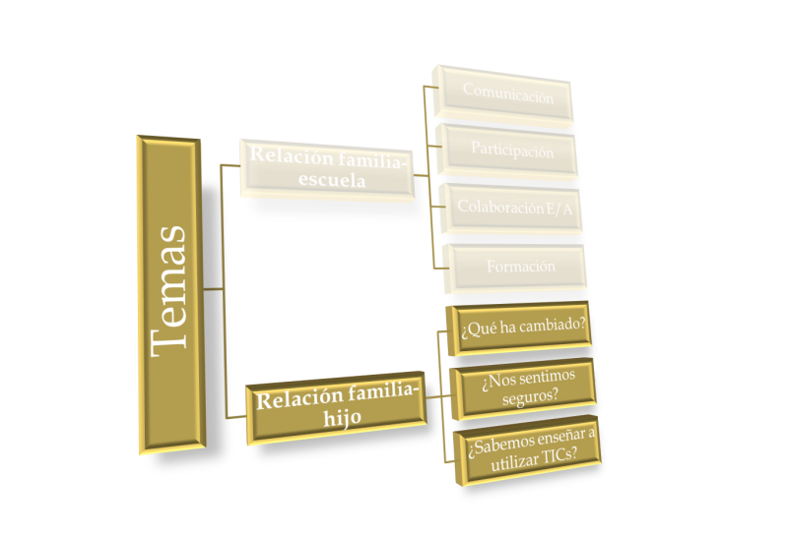
FAMILY-CHILD RELATIONSHIP
REFLECT

Slide 23
Topics
Family-School Relationship
Communication
Participation
Collaboratión E/A
Training
Family-child relationship
What has changed?
Are we feeling safe?
Do we know teaching to use ICT?

Slide 24
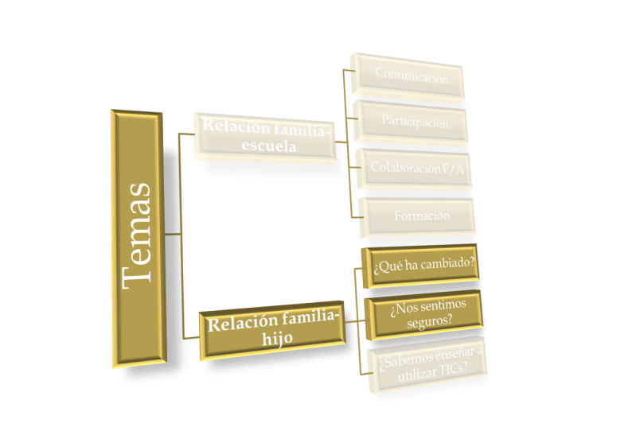
FAMILY-CHILD RELATIONSHIP
CEIP 6 OF DECEMBER
WHAT HAS CHANGED IN THIS RELATIONSHIP?
The children give to their parents new knowledges about the use of the ICT
The parents are becoming aware about the use of the ICT with the MCS principles (Significative, Creative and Safe)
Improve in the relation with their children when both use the internet, parents mobile, tablets, etc.
This course is going to ask for parents-children collaboration for doing works with the school at the Project MCS with the mobile, the computer, the Internet, etc.
DO WE FEEL SAFE?
We are never gonna feel 100% safe, because the New Technologies progress so fast.
We should become aware that we are going to need constant actualization of ourselfs. Our students and children are always going to go ahead of us at the use of the ICT
A part of the formation of the parents is transmitted through the children.
The school should promote the formation of parents through the collaboration with the AMPA to know how to teach the use of the ICT in an appropiate way, MCS way.

Slide 25
FAMILY-CHILD RELATIONSHIP
IES PÉREZ GALDÓS
WHAT HAS CHANGED IN THIS RELATIONSHIP?
The security that provides the possibility of ongoing communication
Ignorance of what your child does when he is without you
The lack of knowledge of a new resource that you do not master
The changing roles of teacher / student in this topic
DO WE FEEL SAFE?
NO. We need to learn and feel that we are not ALONE

Slide 26
Approach
Methodology
Evaluation
What should we do?

Slide 27
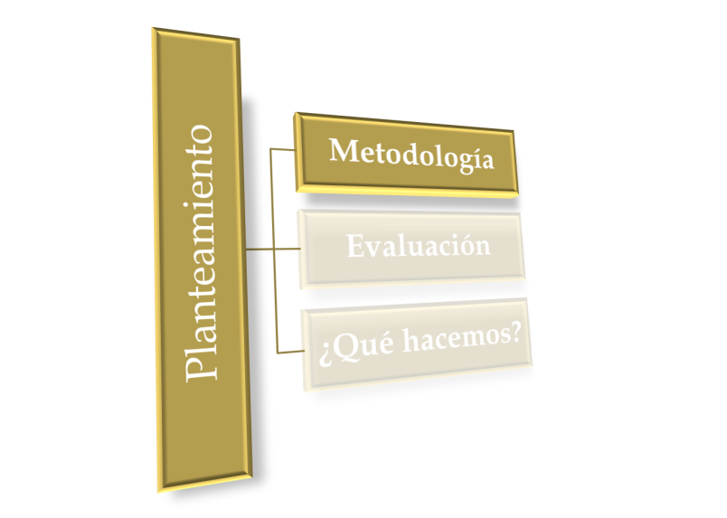
Methodology
The working method would be joint reflection, collaborative learning among us with external training provision if necessary.
The working instrument can range from working with Edmodo, creating a group for us to work with Google docs (contradictory experiences)

Slide 28
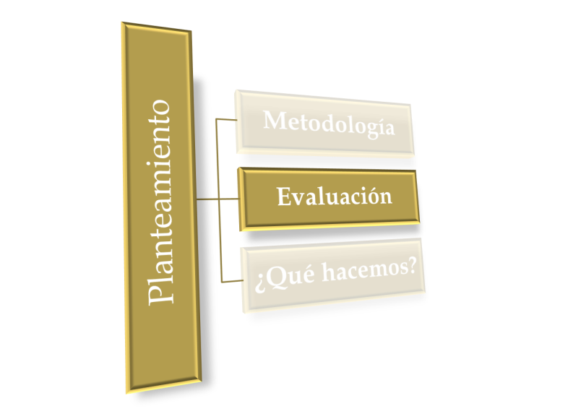

Evaluation
The evaluation would be the collection of activities performed
What will be our criteria?

Slide 29
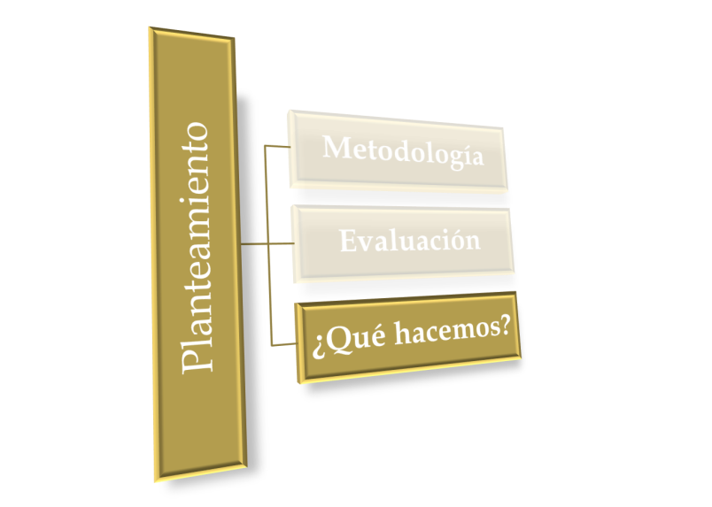
What shoul we do ?
What shoul we do to share experiences?
How to make families
on TIC?
Using ICTs for what?
To facilitate learning
To expand my leisure
To improve my communication
(and even cheaper) Keeping my safety
my freedom
my leisure time
reflect

