Slide 1
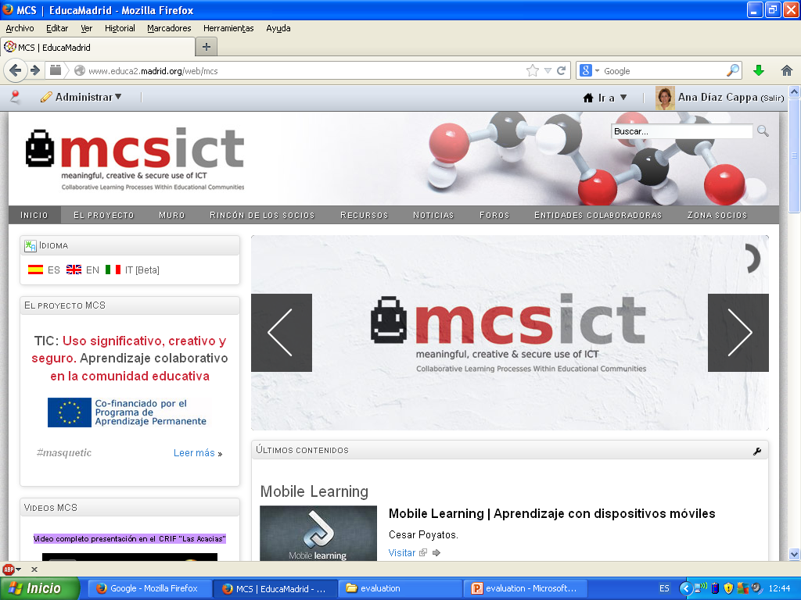

Slide 2
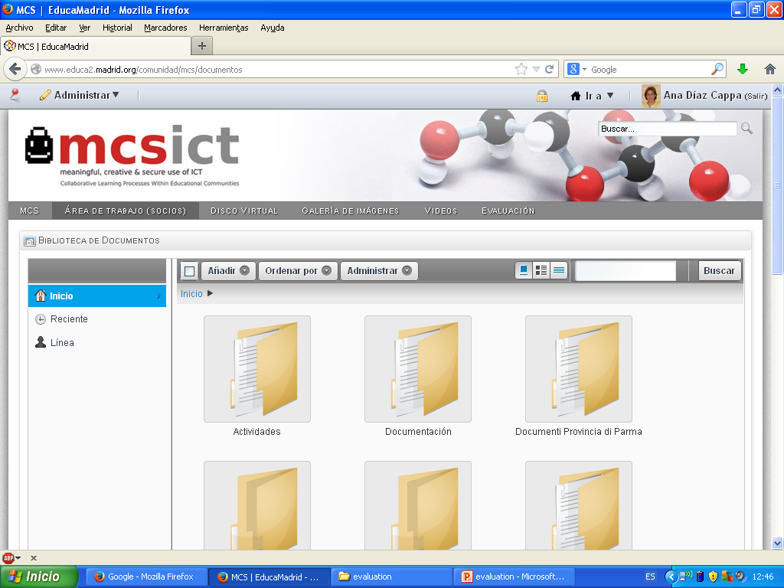

Slide 3
http://www.educa2.madrid.org/web/mcsproject_evaluation/home

Slide 4
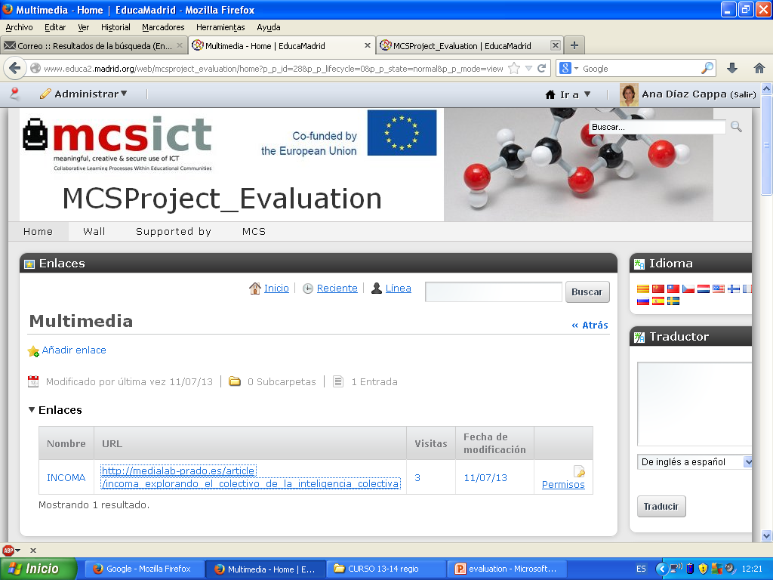

Slide 5
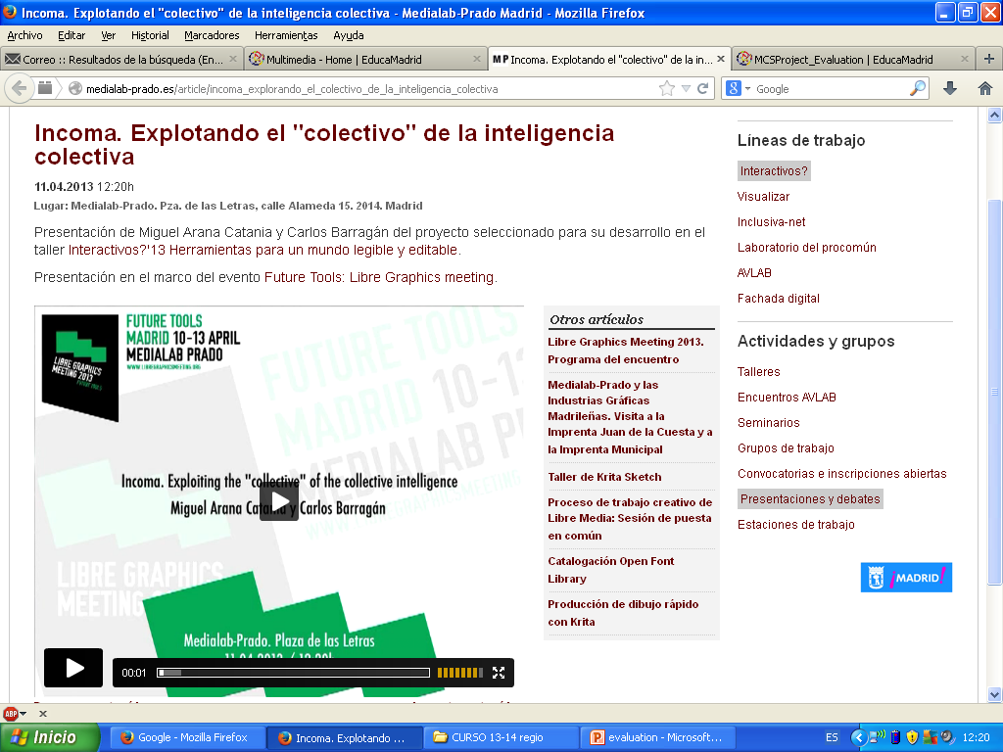

Slide 6
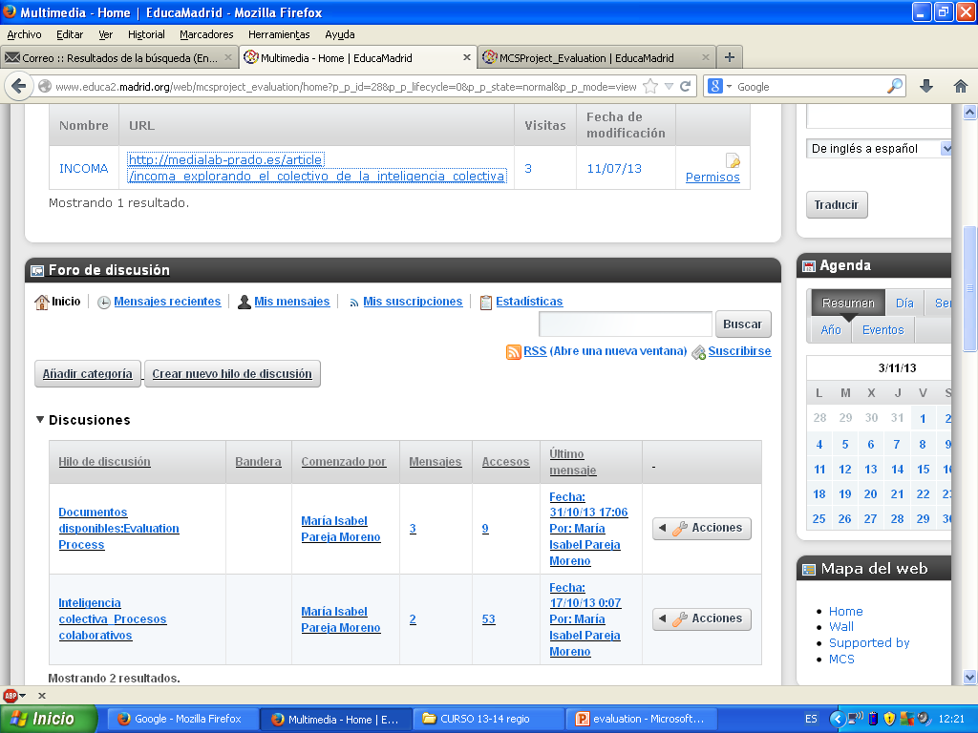

Slide 8
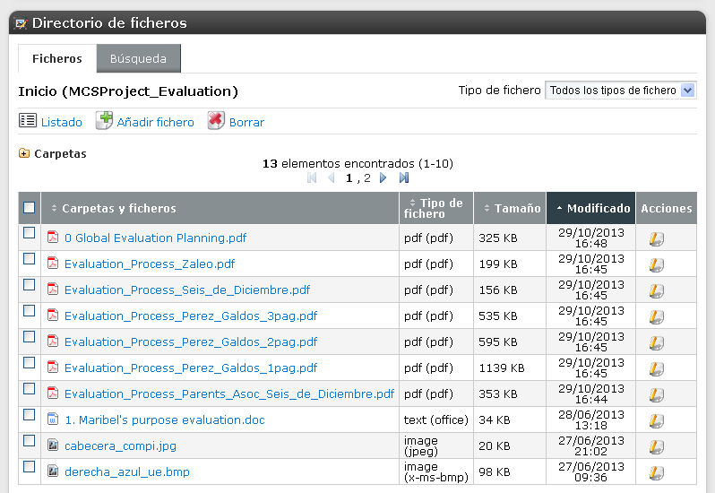

Slide 9
Evaluation commission
From this moment, we would have to:
Fill in the midterm evaluation form
Agreements about future functioning of evaluation commission: Items
Members and future tasks
Final Evaluation: Rubrics?
Definition of “Products”
Giacomo’s “criterial evaluation”
Agenda and Deadlines

